Slide 1
Population and Migration Patterns and processes

Slide 2
BIG IDEAS….
Patterns and Spatial Organization (PSO)
How does where and how people live impact global cultural, political, and economic Patterns?
Impacts and Interactions (IMP)
How does the interplay of environmental, economic, cultural, and political factors influence changes in population?
Spatial patterns and societal change
How do changes in population affect a place’s economy, culture, and politics?

Slide 3
Topic 2.3
Population composition

Slide 4
Enduring Understanding: PSO-2
By the end of this unit you should understand where and how people live is essential to understanding global cultural, political, and economic patterns

Slide 5
Learning objective: PSO 2-E
Describe elements of population composition used by geographers

Slide 6
Essential Knowledge PSO-2.E.1
Patterns of age structure and sex ratio vary across different regions and may be mapped and analyzed at different scales
When looking at age structure we look at them as age cohorts (5 year groups) and split between male and female
Population structure is unique to each area due to their own unique history and current conditions
Good example of this is the lack of females in China due to their one child policy

Slide 7
Learning objective: PSO 2-F
Explain ways that geographers depict and analyze population composition

Slide 8
Essential Knowledge PSO-2.F.1
Population pyramids are used to assess population growth and decline and to predict markets for goods and services
Population makeup (Gender and age) is reflected through population pyramids.
These are all laid out the exact same way every time
Males on left, Females on right
Grouped together in 5 year age cohorts
Population pyramids offer us the ability to quickly and accurately analyze the status of a country and tells us all kinds of details about the country.
We can quickly see whether the state is part of the core, periphery, or semi-Periphery
Or if the local region is experiencing problems

Slide 9
Lets look at some population pyramids and analyze them for different scales and different regions

Slide 10
This shape of a population pyramid – what can be described as evergreen shape is a peripheral country. This means that they are a poorer country
High Death Rate – We know this because the top is narrow so people are not living long
High Birth Rate – We know this because the base is wide

Slide 11
This shape of a population pyramid – what can be described as vase shape is a wealthy core country.
Low Death Rate – We know this because the top is wider and people are living longer
Lower/declining Birth Rate – We know this because the base is not the widest part it is narrower than other areas

Slide 12
Lets compare two side by side to see in detail

Slide 13
Global Scale

Slide 14
Regional scale Sub-Saharan Africa

Slide 15
State
Scale:
South Africa

Slide 16
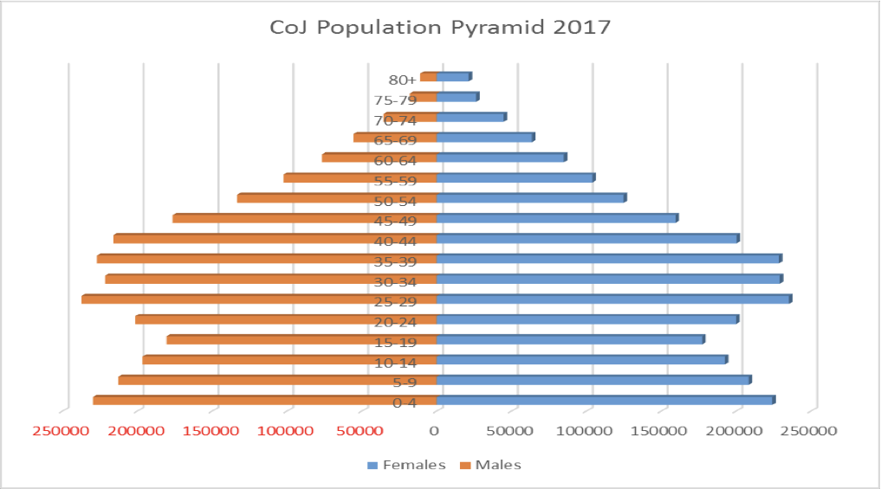
Local
Scale:
Johannesburg South Africa

