Slide 1
World War I
(1914-1918)
AP World History
Chapter 25
“The Collapse and Recovery of Europe”
(1914 – 1970s)

Slide 2
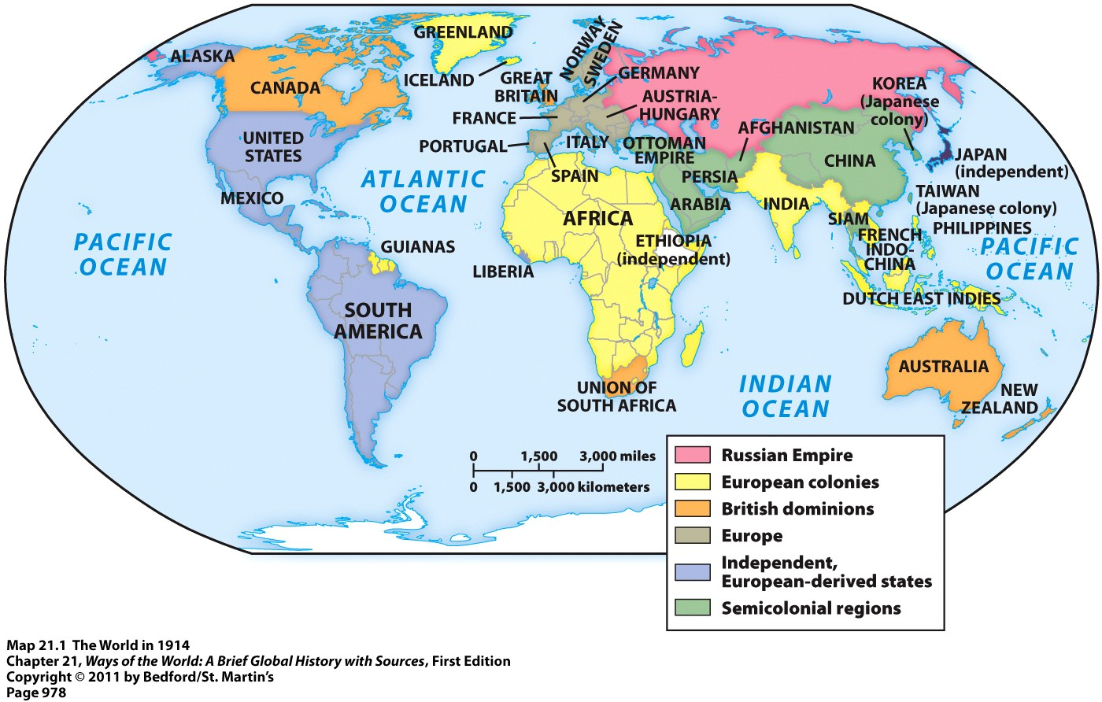
The World in the Early 20th Century
By 1900 = Europeans, or people with a European ancestry, largely controlled the entire world through their formal empires or informal influence
This would all change over the next few decades

Slide 3
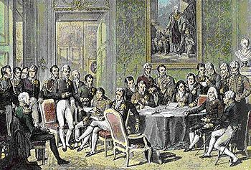
The World in the Early 20th Century
Rivalry and competition between European states continued throughout the 19th and early 20th centuries
Fragile peace was barely being maintained after the defeat of Napoleon and his empire in 1815
  Congress of Vienna (1815) = international meeting held to redraw European boundaries
  Attempt to create a peaceful balance of power in Europe
Rivalries and competition intensified with the unification of Italy and Germany in 1871
The Congress of Vienna (1819)

Slide 4
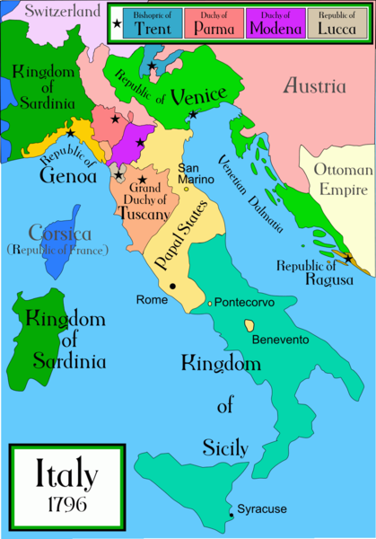
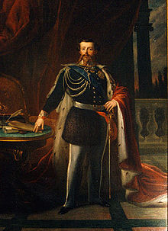
Italian Unification
Italy had been divided up into several independent city-states
Process of Italian unification began following the defeat of Napoleon in 1815
Unified in 1871
1st King of a united Italy = Victor Emmanuel II

Slide 5
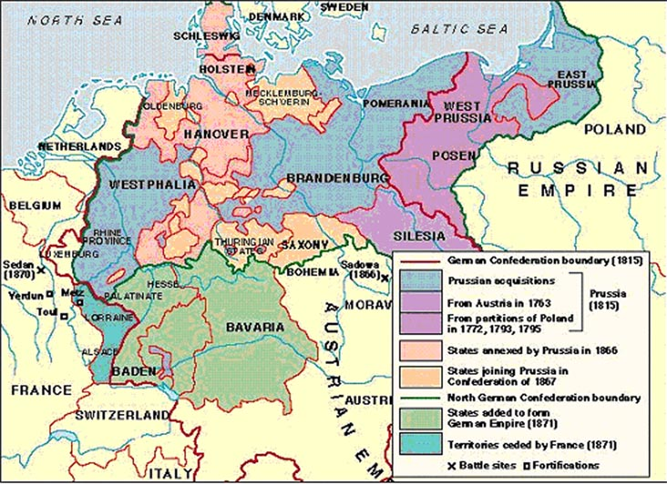
German Unification
Last major European power to unify
Was divided up into 39 independent states
  Largest = Prussia

Slide 6
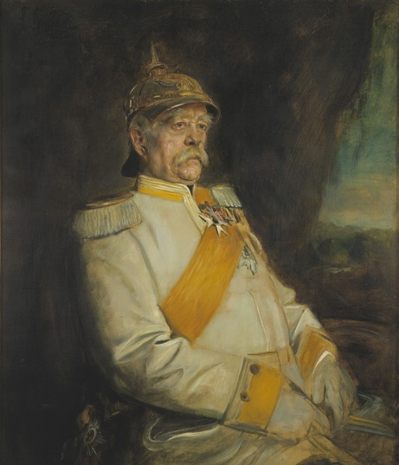
German Unification
Otto von Bismarck = prime minister of Prussia
Wanted strong government & army → unification would come through “blood and iron”
Embraced realpolitik = right of a country to pursue its own advantages by any means, including war

Slide 7
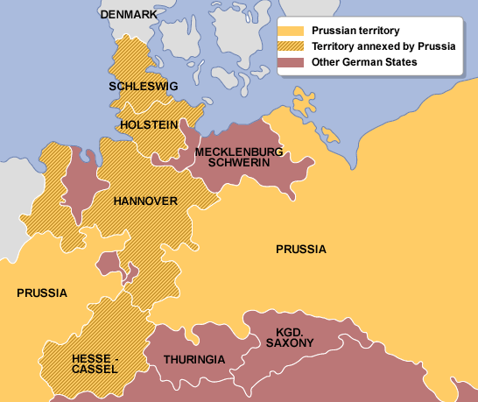
German Unification
1864 = War against Denmark
Denmark ruled Schleswig and Holstein = large German populations there
Bismarck formed a temporary alliance with Austria
  They won
  Prussia got Schleswig
  Austria got Holstein

Slide 8
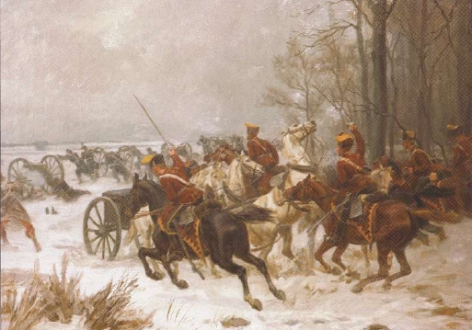
German Unification
1866 = Austro-Prussian War
Bismarck formed alliances with Russia, France, and Italy
  Prevented them from forming alliances with Austria
Bismarck’s goal = to create a Germany under Prussian domination that excluded Austria
  He won
Austria gave Holstein to Prussia
Austria gave Venetia to Italy
Prussian Calvary in the
Austro-Prussian War

Slide 9
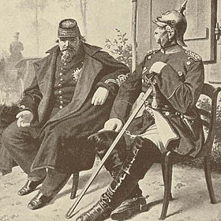
German Unification
1870-1871 = Franco-Prussian War
France = a threat to a united Germany
France demanded some territory from Prussia as compensation for their alliance in the last war
Bismarck refused → eventually led to war between the two nations
  Bismarck won
Prussia gained the French territory of Alsace-Lorraine = major industrial site
Napoleon III of France seated next to Prussian Chancellor Otto von Bismarck, holding Napoleon’s surrendered sword

Slide 10
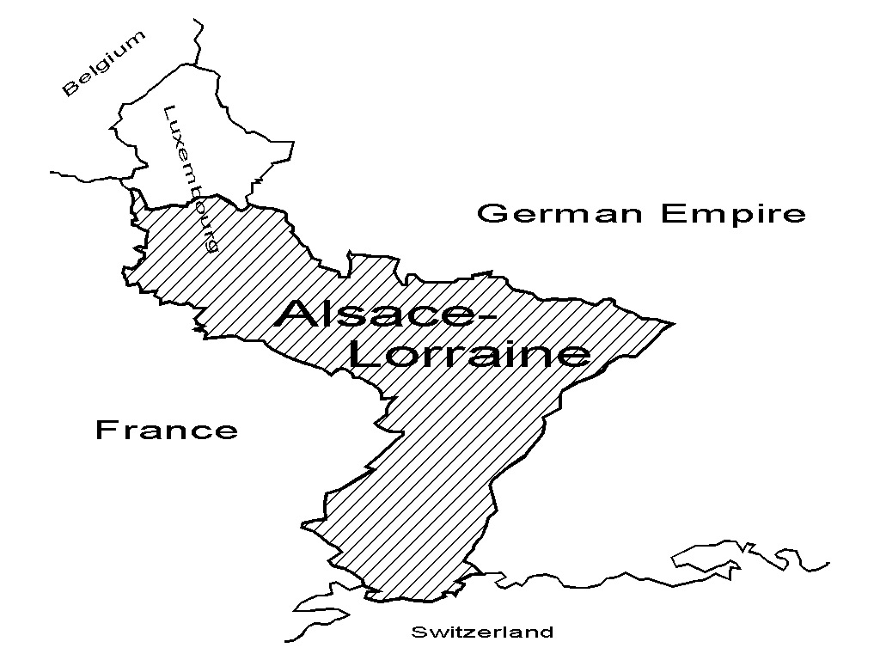
German Unification

Slide 11
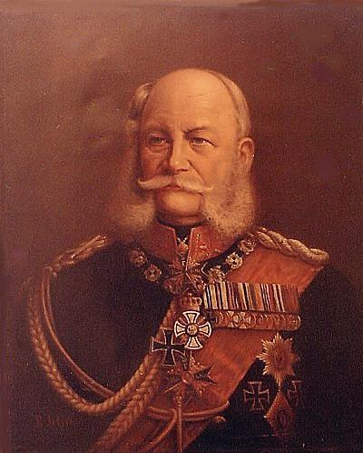
German Unification
Unified in 1871
1st Kaiser (emperor) = Wilhelm I
Bismarck = chancellor = chief minister

Slide 12
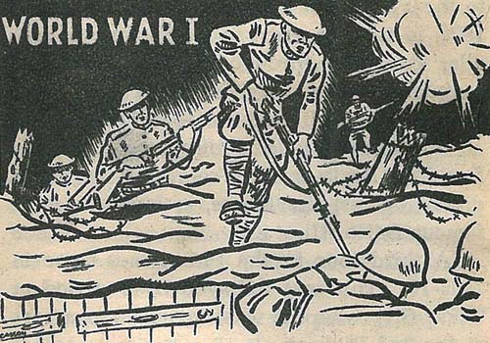
MAIN Causes of WWI
Militarism
Alliances
Imperialism
Nationalism

Slide 13
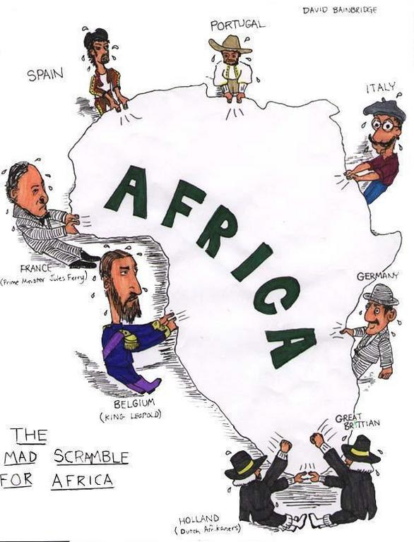
Imperialism
European = imperialist rivalries since the 1800s
Competed for territory and economic power all over the world
  Especially in: Africa, Southeast Asia, the Middle East, China, and the Balkans
Competition turned to hostility and conflict as European’s “got in each other’s way”

Slide 14
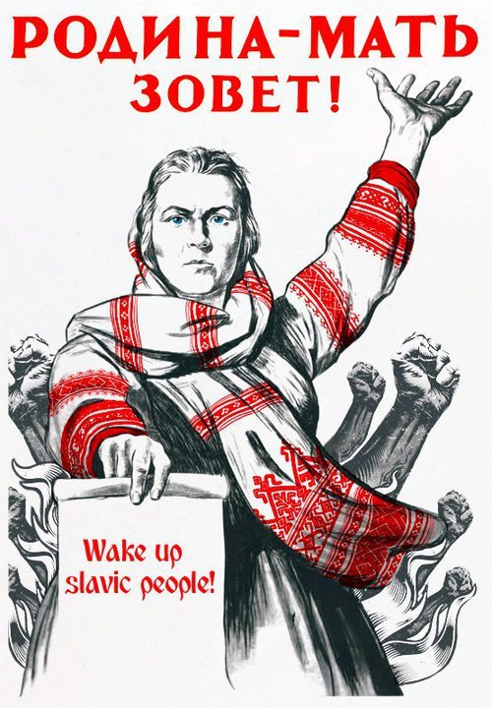
Nationalism
Nationalism had unified Germany and Italy and was becoming more and more popular
The French wanted Alsace-Lorraine back from Germany
In Austrian Empire = nationalism was creating the most violent tensions in Europe
  Pan-Slavism = Slavic nationalism
  Desire to unite all of the Slavic people under one empire

Slide 15
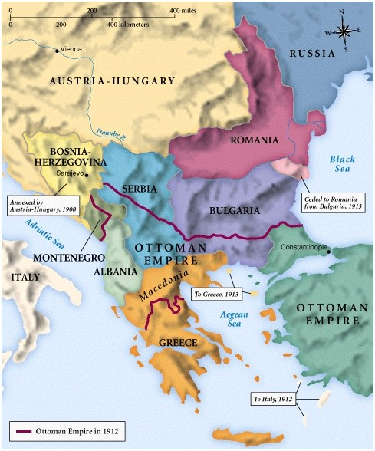
Pan-Slavism
Many Slavic people = in the Austrian and Russian Empires
Many Slavic people = in the Balkans = region once controlled by the Ottoman Empire (which was now falling apart)
Major country in favor of Pan-Slavism = Serbia

Slide 16
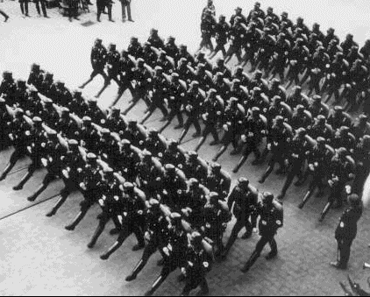
Militarism
Militarism = glorification and expansion of the military
Countries began to build up their militaries and spend money on military training
Many countries began conscription = draft of civilians into the military
Domino effect → when one country enhanced its military, other countries would do the same

Slide 17
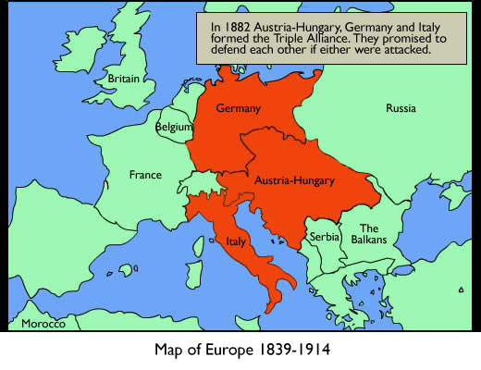
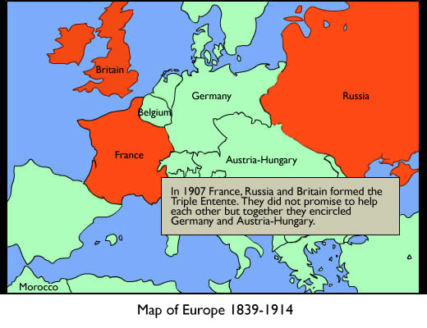
Alliances
Alliance systems = defense agreements among nations
2 major alliance systems:
  Triple Alliance = Germany, Austria-Hungary, and Italy
  Triple Entente = Great Britain, Russia, and France

Slide 18
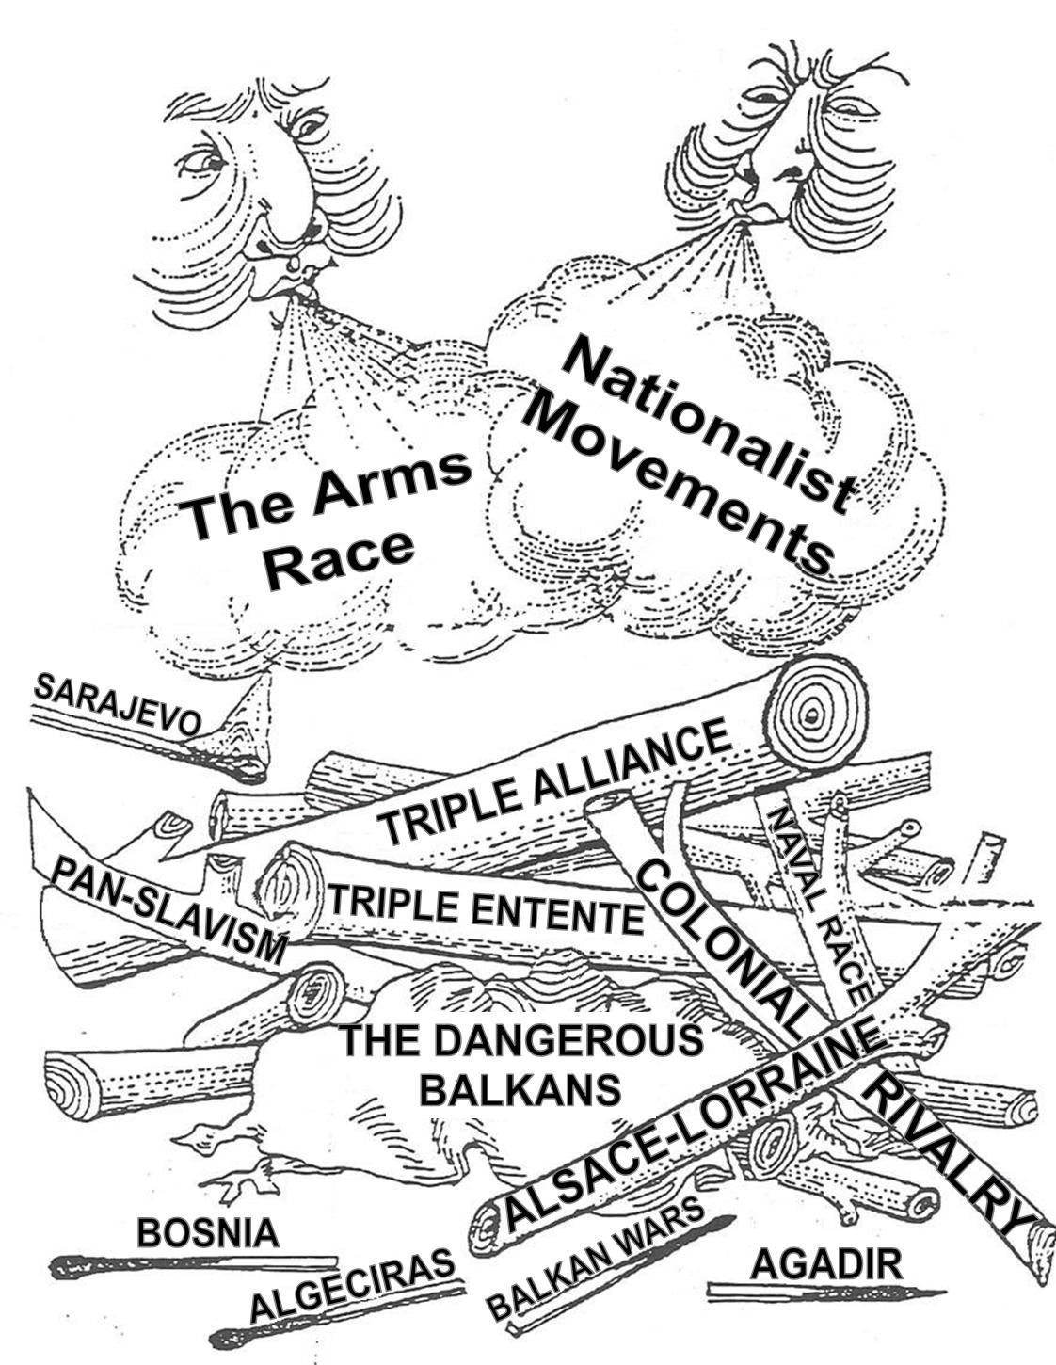

Slide 19
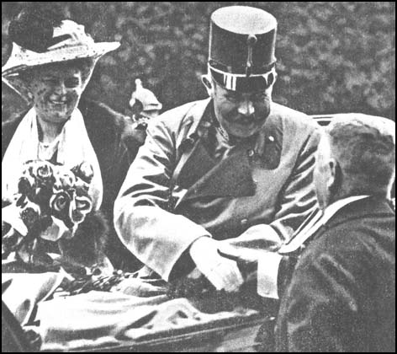
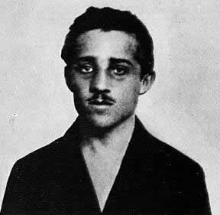
The “Spark” of WWI
June 28, 1914 = Archduke Francis Ferdinand (heir to the throne in Austria-Hungary) was assassinated
His wife Sophie was also killed
Both were in Sarajevo = capital of Bosnia-Herzegovina
  A territory controlled by Austria-Hungary with a very big Slavic population
Murdered by Gavrilo Princip = member of the Black Hand = secret Slavic nationalist group

Slide 20
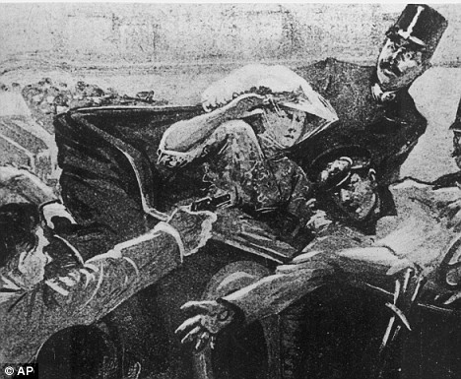
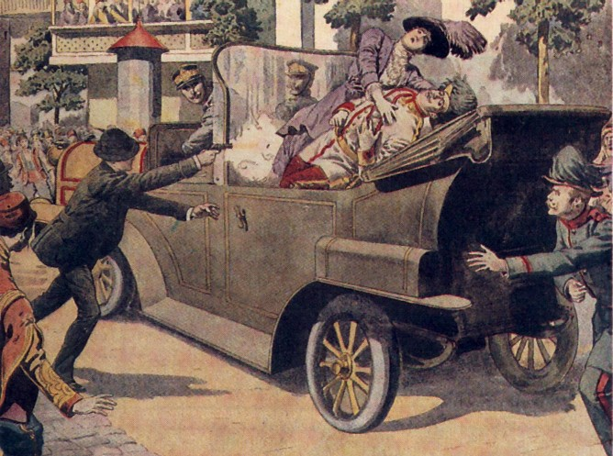
The Assassination

Slide 21
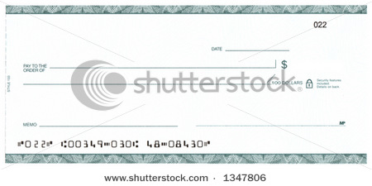
German Support
Austria-Hungary approached Germany and made sure that Germany would support it if it took action against Serbia
Germany promised a “blank check” of support
  Unconditional and full support

Slide 22
Declaration of War
Austria-Hungary gave Serbia an ultimatum
1) Serbia must let A-H officials into the country to stop all violent, nationalist movements
2) Serbia must let A-H officials into the country to investigate the assassination
Serbia said: NO
July 28, 1914 = A-H declared war on Serbia
Both countries started mobilization = preparing the military for war

Slide 23
A European War
Russia began to mobilize
  Supported Serbia and Pan-Slavism
France began to mobilize to support Russia
Germany gave Russia and France an ultimatum = stop mobilizing or face war
  They didn’t stop
  Germany declared war on Russia and France
Great Britain tried to stay neutral

Slide 24
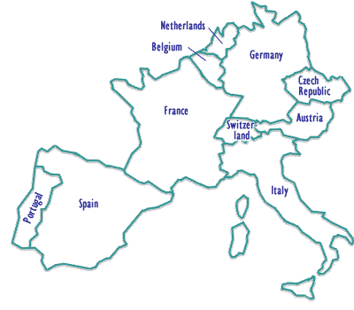
A European War
August 1914 = Germany invaded neutral Belgium in order to get to France
This led Great Britain to declare war on Germany
  Did not like that Germany was getting so close to them
  Did not like that Germany was invading neutral countries

Slide 25
Other Nations Join the War
For the Central Powers (formerly the Triple Alliance):
  1914 = Ottoman Empire
  1915 = Bulgaria
For the Allied Powers (formerly the Triple Entente):
  1914 = Serbia, Belgium, Montenegro, Romania, Greece, Portugal
  1914 = Japan → wanted German territories in the Pacific
  1915 = Italy switched alliances → Allies promised Italy territories in A-H when they won
  1917 = U.S.

Slide 26
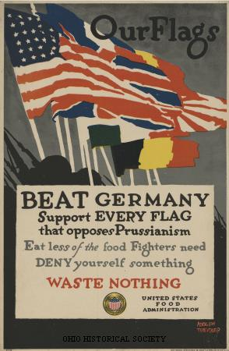
Response of the People
People in every country responded with patriotic enthusiasm
  Cheered for their country
  Supported their troops
Nobody knew how devastating the war would actually be to Europe
  (No country stockpiled more than 6 months worth of ammunition and supplies)

Slide 27
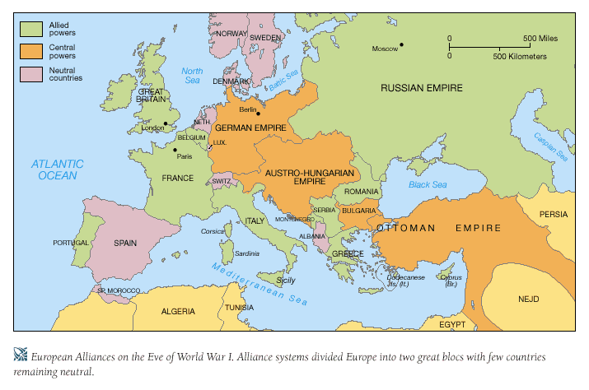
Europe in 1917

Slide 28
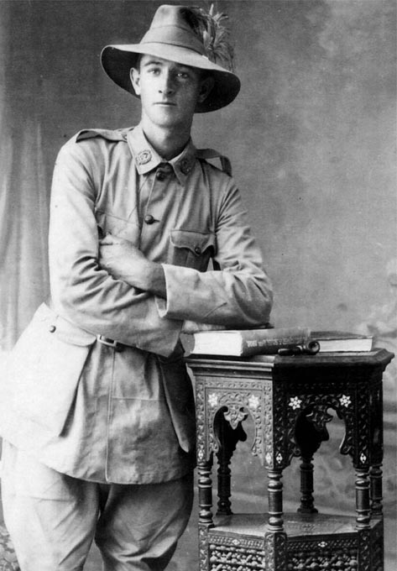
Military Aspects of WWI
Worldwide involvement = first time in world history that all major nations were involved in a war
  Every continent provided troops for combat
  Colonial troops and laborers funneled in from Africa, India, China, Southeast Asia, Australia, New Zealand, Canada, and South Africa
A Young Australian Recruit

Slide 29
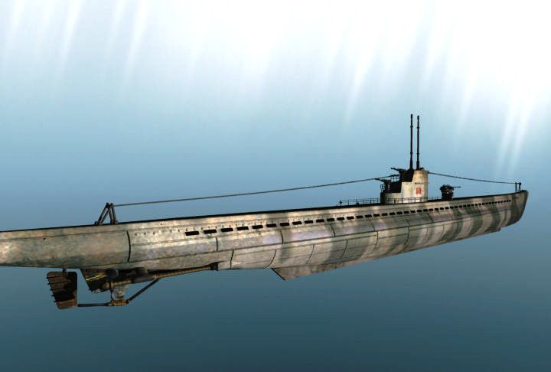
Military Aspects of WWI
Naval warfare = battles between the British and German navies were very common
  They would also set up blockades to stop each other from receiving food & materials
  Germans used U-Boats = submarines

Slide 30
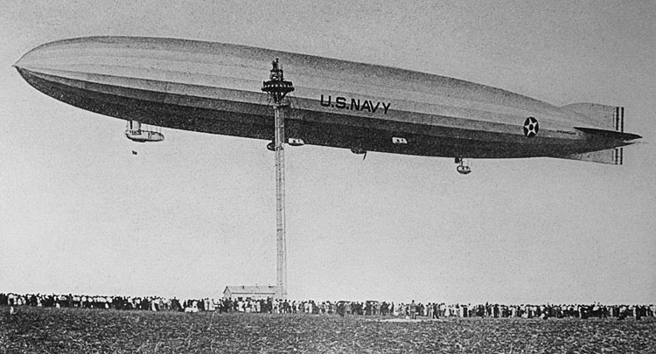
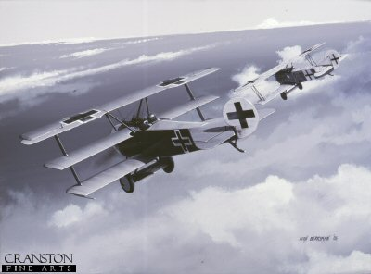
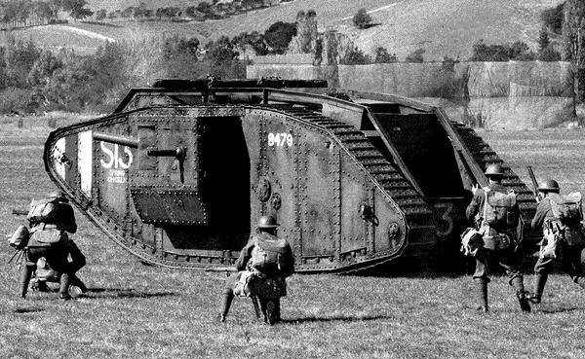
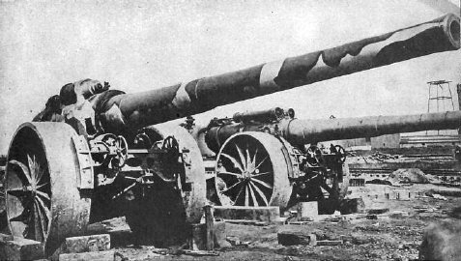
Military Aspects of WWI
New Weapons
  Dirigibles (airships)
  Submarines
  Machine guns
  Giant artillery guns
  Tanks
  Airplanes
  Poison gas
  Gas masks

Slide 31
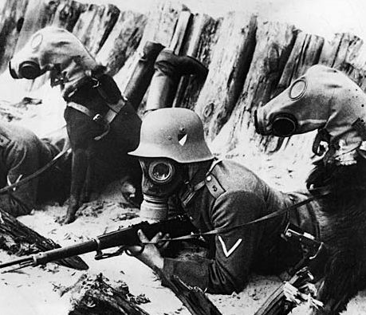
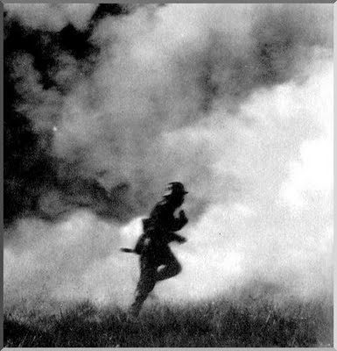
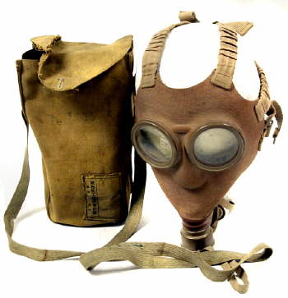

Slide 32
Military Aspects of WWI
Trench Warfare
  Used on the Western Front
  Complex system of trenches and tunnels
  Soldiers would be in them for several weeks at a time
  Soldiers suffered from boredom, disease, rats, mud, cold, standing water, etc.
  “Trench foot” = when the feet would begin to rot and decay due to exposure to water and cold
    Often got infected → could lead to gangrene

Slide 33
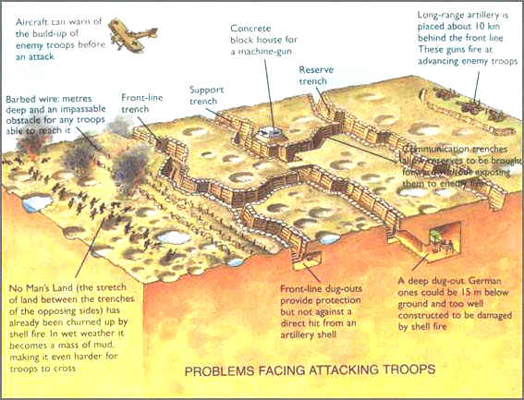

Slide 34
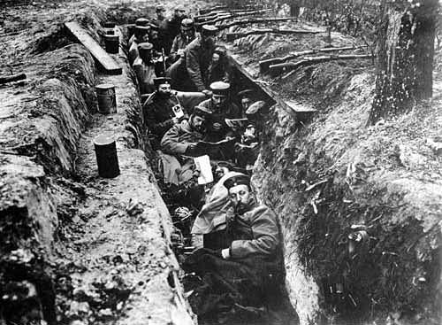
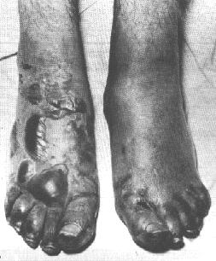
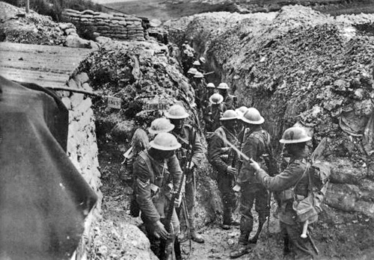
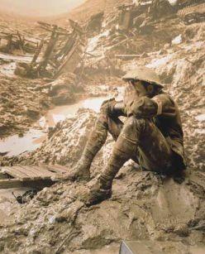

Slide 35
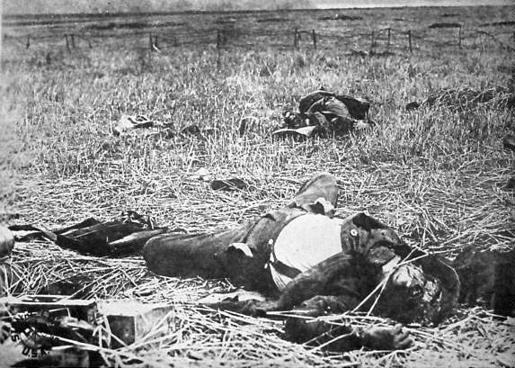
Military Aspects of WWI
Trench Warfare (cont.)
  Trenches were surrounded by barbed wire -- men often got caught in it
  Space in between the trenches = “No man’s land”
  “No man’s land” = scattered with land mines
  WWI became a war of attrition = trying to wear down the other side with constant attacks

Slide 36
WWI = “Total War”
Total War = countries involved used every resource available for the war effort
On the home front = people mobilized resources for the military front
  Hole in the workforce because the war took any men old enough to fight
  Women went to work in the factories
  Poor people benefited from new work
  Factories made war products instead of domestic products
  “War socialism” = governments took more control over the economy during the war; needed war supplies

Slide 37


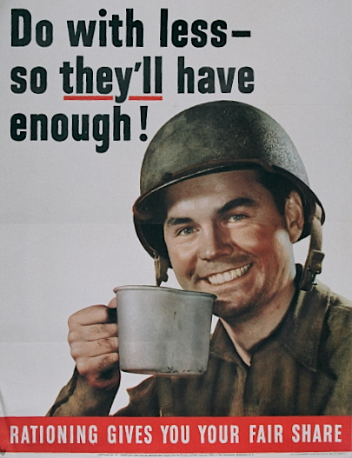
WWI = “Total War”

Slide 38
Major Theaters of War
“Theater” of war = the location
In WWI = 2 theaters
  Western Front
  Eastern Front

Slide 39
Western Front
Plan XVII = French plan to go on offensive attacks without concern for the opponent’s strategy
  Led to mass casualties in the war
Schlieffen Plan = Germany’s military plan to avoid war on 2 fronts

Slide 40
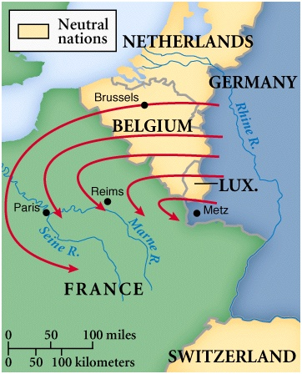
The Schlieffen Plan
Created by German General Alfred von Schlieffen
Plan = go into France through Belgium and conquer France, THEN turn back around through Germany to get Russia
  Believed Russia would be slow to mobilize because so large
  Paris = objective of German push in France after getting through Belgium

Slide 41
Problems with the Schlieffen Plan
The Germans met much more resistance in Belgium than they anticipated
  - This slowed the Germans down
  - This depleted German resources, troops, etc.
The slowdown in Belgium gave British troops a chance to come over and join the French troops for support
Russia mobilized a lot faster than Germany thought it would
  - This forced Germany to end up fighting on 2 fronts

Slide 42
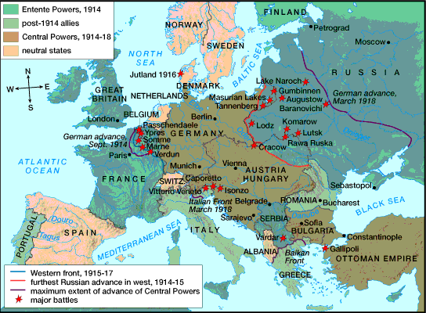
A Multi-Front War

Slide 43
Stalemate on the Western Front
Both sides continued to fight with neither side making any real progress
Both sides were losing troops, ammunition, supplies, food, medicine, etc.
Both sides had to change their war strategy:
  Recruitment of Civilians
  Propaganda = used by the government to make the enemy look beastly and inhuman

Slide 44
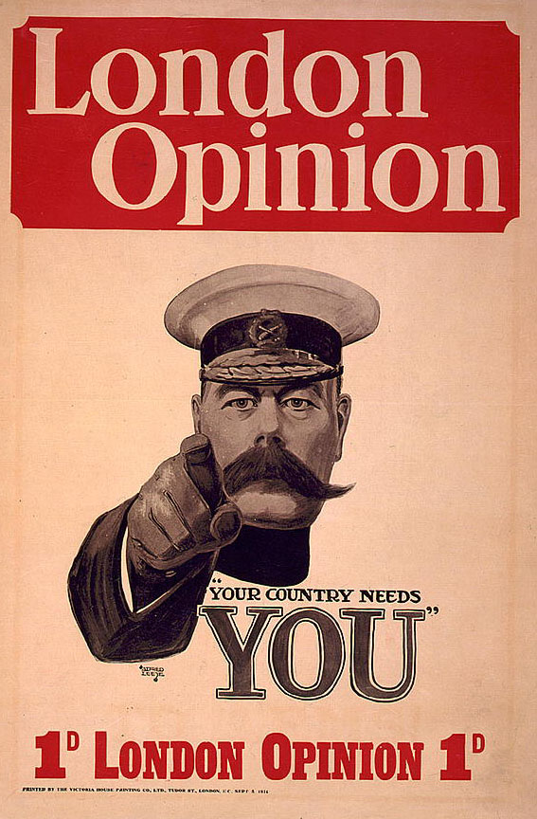
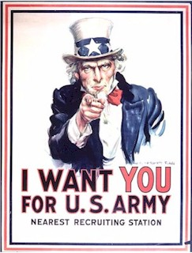
Recruitment Posters

Slide 45
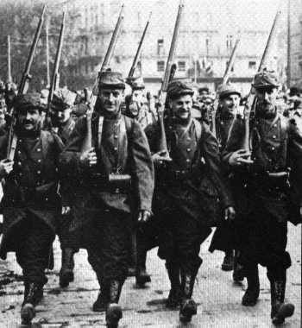
New French Recruits

Slide 46
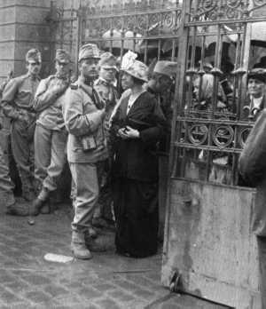
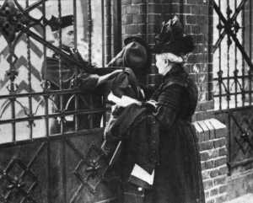
Recruits of the Central Powers
A German Soldier Says Farewell to His Mother
Austro-Hungarians

Slide 47

A German Boy Pretends to be a Soldier

Slide 49

War Propaganda
Australian Poster

Slide 50

War Propaganda
American Poster

Slide 51

War Propaganda
Financing the War

Slide 52

War Propaganda
Think of your children!
German Poster

Slide 53

Major Battles on the
Western Front
Battle of the Marne
Battle at Verdun
Battle of the Somme
Second Battle of the Marne

Slide 54

Battle of the Marne
September 1914
French vs. German troops
French stopped German advances
Not strong enough to push them all the way back to Germany
Pushed the Germans back 50 miles away from Paris
Saved Paris
Boosted morale for the French

Slide 55

Verdun - February 1916
German offensive
  Sneak attack
  Broke out of trenches and attacked French city of Verdun
Longest battle in the war
  6 months
  Germans finally abandoned attack
  Result = stalemate
Each side had 500,000 casualties

Slide 56

The Somme - July 1916
British forces attacked the Germans to take the pressure off French troops in Verdun
No advancement or gain for either side
1.1 million dead
  500,000 German troops dead
  400,000 British troops dead
  200,000 French troops dead

Slide 57

Second Battle of the Marne
July 1918
Germans tried one more time to get Paris
Within a month, the U.S. sent 2 million American troops to help the French there
Fresh Americans = deciding factor in the war
  They helped the Allies push the Germans back to Germany & forced them to surrender

Slide 58



Sacrifices in War

Slide 59



Sacrifices in War

Slide 60

The Eastern Front
Didn’t use trench warfare
War here = mobile and involved constant changes in battlefield positions
Neither side ever achieved a complete victory here either

Slide 61

The Russian Disaster
August 1914
Russians invaded eastern Germany
Diverted German troops from the Western Front
But Russia ended up suffering a disastrous defeat
  30,000 Russians killed
  92,000 Russians taken prisoner

Slide 62
Continuous Russian Defeats
1914 - 1917 = Russia continued to suffer harsh defeats by German armies
  Lost millions of men, supplies, ammunition, guns, etc.
  Morale in Russia = VERY LOW
Although the Russians suffered, their efforts helped the Allies over on the Western Front

Slide 63

The U.S. Enters the War
President Woodrow Wilson had issued the Proclamation of Neutrality
  Said that U.S. would stay neutral in WWI
But world events led the U.S. to get involved in the war
  In 1917 = the U.S. declared war on Germany

Slide 64

The U.S. Enters the War
U-Boats
  Germans used unrestricted submarine warfare = subs attacked without warning & attacked commercial ships also
  Subs = called “U-Boats”
  Subs used to blockade England and weaken its navy
  Germans torpedoed ships of neutral nations
  1915 = a U-Boat sank an American passenger liner = the Lusitania
    1200 people killed -- 128 Americans

Slide 65


The Lusitania

Slide 66

The U.S. Enters the War
Allied Propaganda
  Americans felt receptive to it
  We felt connected to England -- common language and culture
  We had a friendship with France since way back when they helped us in the Revolutionary War

Slide 67

The U.S. Enters the War
The Zimmerman Telegram
  Intercepted by the British & given to U.S.
  Sent from Germany to Mexico
  Said that if Mexico supported Germany in WWI, then Germany would help Mexico get land it lost to U.S. in Mexican-American War

Slide 68

The U.S. Enters the War
American Economic Interests
  Americans sold food and manufactured goods to the Allies
  Made loans to the Allies → afraid that if Germany won, their loans would never get repaid

Slide 69
The U.S. Enters the War
American Security
  If Germany won, it would become the dominant power in Europe
  Germany could take over Great Britain and be closer to the U.S.
    Threatened U.S. security
American Idealism
  U.S. believed the world would be a better place if the Allies won

Slide 70

Significance of the U.S. in WWI
Turned the tide of WWI in favor of the Allies
Broke sharply with America’s traditional avoidance of foreign conflicts
Marked America’s emergence as a world power → eventually led to world leadership

Slide 71

Turning the Tide
When the U.S. joined WWI, the Allies got:
  More resources
  More troops
  Boosted morale
American involvement changed WWI
  No more stalemate
  Allies now had the advantage
  The U.S. helped the Allies push the Germans back to the German border

Slide 72

Germany Surrenders
September 1918 = German generals von Hindenburg & Ludendorff told Kaiser Wilhelm II that the war could not be won
Collapse of Central Powers followed

Slide 73

Germany Surrenders
November 9, 1918 = Kaiser abdicated and a German republic was proclaimed
November 11, 1918 = Germans signed an armistice = agreement to end the fighting

Slide 74

Wilson’s 14 Points:
Trying to Restore the Peace
Freedom of the seas
Removal of international trade barriers
Reduction in arms
End to secret alliances
Adjustment of European boundaries according to nationality
League of Nations = “general association of nations”
14 Points = guiding framework for peace settlement

Slide 75

Paris Peace Conference
January 1919
Representatives from 27 nations met
No one from Central Powers or Russia invited
5 separate peace treaties signed
  Biggest one = Treaty of Versailles
Most decisions made by the “Big Four”

Slide 76




The “Big Four”
Prime Minister Vittorio Orlando (Italy)
President Woodrow Wilson (U.S.)
Prime Minister Georges Clemceau (France)
Prime Minister David Lloyd George (Britain)

Slide 77
Treaty of Versailles
Signed June 28, 1919
Territorial Provisions
- Germany gave Alsace-Lorraine to France
- Germany gave Saar coal mines to France
- Germany gave small areas on its border to Denmark and Belgium
- Other border changes were made based on nationality

Slide 78


Slide 79
Treaty of Versailles
2) Colonial Provisions
- Germany had to give up all of its overseas colonies to the Allies
- Great Britain & France split Germany’s colonies in Africa
- Australia took German Pacific islands south of the Equator
- Japan took German Pacific islands north of the Equator

Slide 80

League of Nations Mandates in Africa

Slide 81

German Pacific Colonies
Lost After WWI

Slide 82

Treaty of Versailles
3) Disarmament
- German army limited to 100,000 volunteers
- Submarines & aircrafts banned in Germany
- Draft banned in Germany
- German navy reduced to a few small ships
- Demilitarization of the Rhineland in Germany

Slide 83
Treaty of Versailles
4) War Guilt Clause and Reparations
- Germany had to accept SOLE responsibility for the war
- Germany had to pay reparations = payments for all war damages

Slide 84

Treaty of Versailles
5) Creation of the League of Nations
- Ended up being very weak
- U.S. Senate refused to join
- Not enforced well
- Not strong enough to stop WWII
- Collapsed in 1940

Slide 85
Other Settlements
Austria-Hungary broke up
New nations emerged in Europe out of the old German, Russian, and Austro-Hungarian Empires
In the Middle East, the Allies divided up what was left of the Ottoman Empire

Slide 86

New Nations: 1923

Slide 87

League of Nations Mandates in the Middle East
Mandate = a territory administered by another country

Slide 88
Results of WWI
WWI destroyed the lives and homes of millions of people
Many people found themselves to be minorities in newly formed nations
Many people who thought they would become citizens of independent nations saw their dreams dashed
Losing side = bitter about the outcome
Most bitter country after WWI = Germany
  Left weak and humiliated as a result of the Treaty of Versailles

Slide 89
Results of WWI
Social Results
  10 million soldiers killed
  20 million soldiers wounded
  13 million civilians died = from getting caught up in the war, disease, starvation, etc.
  World left with hatred, intolerance, and extreme nationalism

Slide 90
Results of WWI
Political Results
  U.S. emerged as a leading world power
  Breakdown of empires & monarchies
  New countries emerged in Europe
  Many European countries would eventually turn to dictatorship
    Italy, Germany, and Russia

Slide 91
Results of WWI
Economic Results
  Total cost of WWI = $350 billion
  Taxes increased in Europe to pay for the war
  International trade declined
  Economic issues eventually led to the Great Depression
    Worldwide – not just in the U.S.

